Slide 1
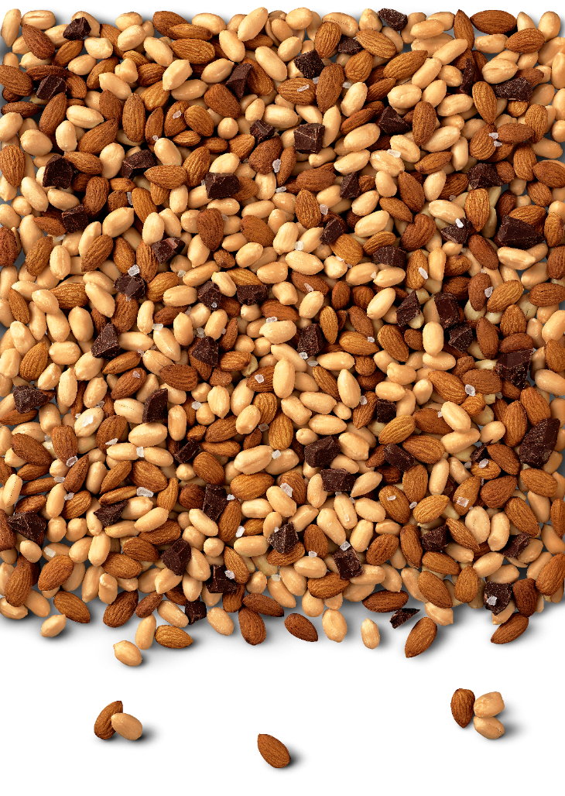




Activation Effectiveness Analysis -
Phase 1
(April 1, 2020)
France
Italy
Russia

Slide 2
Activation Effectiveness
Objective
Identify key activation levers that drive volume growth and optimize their investment budget
Which marketing activation/investment mix & distribution pace delivers the highest RSV growth
How should an investment priority ranking & distribution target across all levers for markets look like?

Slide 3
Agenda
Project Scope
Problem Context & Methodology
Cross - country Executive Summary
Market Findings and Insights
Potential Next Steps

Slide 4




Phase 1
Phase 2
Phase 3
We are following a 3 phased approach for end-to-end activation mix budget planning
25th Feb – 31st Mar (5 Weeks)
1st Apr – 20th Apr (3 Weeks)
TBD
Pre-Modeling and Modeling
Identifying data, Feature engineering and Driver analysis
Deep dive & Optimization
Deep dive on all 6 markets in unison to provide guidelines
Based on the contributions of different components, optimal budget allocation can be drawn out for different marketing supports
France
Italy
Russia
UAE
Germany
Ireland
Weeks of observation
(56 Weeks)
(38 Weeks)
(31 Weeks)
(22 Weeks)
(20 Weeks)
(31 Weeks)

Slide 5
Agenda
Project Scope
Problem Context & Methodology
Cross- country Executive Summary
Market Findings and Insights
Potential Next Steps

Slide 6



A four step approach was followed to identify and quantify the impact of key activation levers driving revenue growth
Data harmonization
Feature Engineering
Key Lever Analysis
Budget Allocation Optimization
Bring all the required data together at week level
Paid Media & Owned media data transformation for every post to week level
Events & Proximity sampling data transformation from event level to week level
Instore demo data transformation for each demo to week level
Different metrics for each lever in every market to standardize
Identify the right metrics to act as model inputs
Analyze the coverage of different metrics of marketing levers based on data points
Find correlations of chosen metrics to identify the significant ones
Iterations of the analysis to select a significant metric for levers
Use supervised machine learning models (LASSO Regression)
To identify, isolate, & quantify impact of key levers
To reduce the impact of insignificant levers and give more importance to significant ones
Easily interpret the model and translate the results into volume uplifts to enable business decisions
Used simplex method, a linear programming algorithm to optimize and allocate spending thereby maximizing sales.
Current approach does not account for constraints like maximum budget, min-max spends per lever, etc.

Slide 7
A four step approach was followed to identify and quantify the impact of key activation levers driving revenue growth
Data Harmonization
Feature Engineering
Key Lever Analysis
Budget Allocation Optimization
Syndicate the data from different sources at the required level (post/event/ demo/sales at week levels)
Paid Media (IG, FB & Videos)
Owned Media (IG, FB, VK)
Events & Proximity sampling
Instore demo data
RSV Data
Identify the right set of metric to use in the supervised model based on different analysis like quality, univariate, bivariate, correlation, etc.
Use supervised machine learning models (LASSO Regression) to identify key levers and their impact
Identify, isolate, & quantify impact of key levers
Used simplex method,
a linear programming algorithm to optimize and allocate spending thereby maximizing sales
Current approach does not account for constraints like maximum budget, min-max spends per lever, etc.

Slide 8
Agenda
Project Scope
Problem Context & Methodology
Cross- country Executive Summary
Market Findings and Insights
Potential Next Steps

Slide 9
Cross – Country Summary
What’s similar & what’s not?

Slide 10

Cross – Country Summary
Across markets, engaging with the consumers directly either through Paid Media(IG & Display/Videos), Influencer marketing or Instore demo has shown significance in driving the sales (direct uplift/brand awareness)
Owned Media Instagram has performed better in France & Russia with a volume uplift ranging from 3% to 16% (from its respective baseline)
Instore demo has performed well in all the markets with a volume uplift ranging from 1% to 4% (from its respective baseline)
Event sampling has performed better in France & Russia with a volume uplift ranging from 0.5% to 2% (from its respective baseline)
Among all the social media platforms, Instagram (across paid media, influencer marketing & owned media) has shown significant impact on sales uplift
Proximity sampling does not have the right level of data to draw a conclusion (FR, RU & IT)
*Additional details explained in each market insights
Accuracy : Adjusted R squared score has been observed to be 0.85, 0.63 & 0.51 for the FR, RU & IT markets respectively

Slide 11
Agenda
Project Scope
Problem Context & Methodology
Cross- country Executive Summary
Market Findings and Insights
Potential Next Steps

Slide 12
First level market insights
France

Slide 13
KEY INSIGHTS
Paid Media(Instagram) and Owned Media(Instagram) have the most significant impact on sales volume followed by Instore demo and event sampling
Additional investment on Paid media (Instagram) is the single most important factor to drive sales volume
By focusing on Paid Media(IG) and Owned Media(IG), KIND can see a sales volume increase of 8.4% and 3.5% or higher, respectively (per $100 spend for each lever)
Inconclusive levers (due to data unavailability/granularity): Proximity Sampling, Search Engine Advertisement and Influencer Marketing
Insignificant marketing levers* are Owned Media (Facebook) and Paid Media (Facebook)
**WD has been studied separately
*On the basis of modeling technique
All the % lifts have been calculated from baseline volume

Slide 14


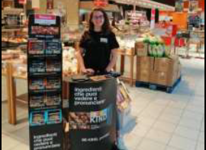
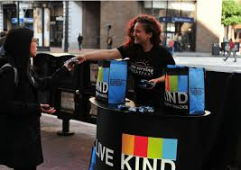
For same investment, Paid Media – Instagram will cause a greater impact than compared to other levers
Ranking of marketing levers based on volume uplift
Personalized contact with consumers through paid or owned IG and instore demos will help drive better sales
1
2
3
4
Paid Media - Instagram
Owned Media - Instagram
Instore Demo
Event Sampling
VOLUME LIFT OPPORTUNITY
8.4 %
3.5%
1.9%
0.4%
*Volume uplift has been calculated using the baseline volume of 2750 units
*Results are based on immediate lift achieved
*The levers like proximity sampling, owned media –Facebook, paid media – Facebook, influencer marketing and SEA came out to be insignificant/inconclusive

Slide 15
Optimally allocate spends to various activation levers in order to maximize uplift and revenue
For every $100K investment
~68.5% budget – Paid Media - IG
~10.5% budget – Owned Media - IG
~10.5% budget – Instore Demo
~10.5% budget – Event Sampling
For a newly launched product activation campaigns should enable both immediate volume uplift and increased brand awareness.
The optimization of investments will depend on the objective to be achieved. Uplift vs Brand awareness
It will also be governed by constraints like, Total marketing budget, Min cost per lever, min events/campaigns/demos needed, and other business constraints
*Phase 3 will deal with constraints-based optimization technique

Slide 16
First level market insights
Russia

Slide 17
KEY INSIGHTS
Owned Media(IG) and Instore demos have the most significant impact on sales volume followed by event sampling
By focusing on Owned Media and Instore demos, KIND can see a sales volume increase of 16% and 4.4% or higher, respectively (per $100 spend for each lever)
Inconclusive levers (due to data unavailability/granularity): Influencer Marketing, Proximity sampling & Paid Media
**WD has been studied separately
*On the basis of modeling technique
All the % lifts have been calculated from baseline volume

Slide 18
For same investment, Owned Media (IG) will cause a greater impact than compared to other levers
Ranking of marketing levers based on volume uplift
Personalized contact with consumers through owned media and instore demos will help drive better sales
1
2
3
Owned Media - Instagram
Instore Demos
Event Sampling
VOLUME LIFT OPPORTUNITY
16 %
4.4 %
1.7 %
*Volume uplift has been calculated using the baseline volume of 1010 units
*Results are based on immediate lift achieved
*The levers like proximity sampling, paid media & influencer marketing came out to be inconclusive

Slide 19
Optimally allocate spends to various activation levers in order to maximize uplift and revenue
For every $100K investment
~93.4% budget – Owned Media
~3.3% budget – Instore Demos
~3.3% budget – Event Sampling
For a newly launched product activation campaigns should enable both immediate volume uplift and increased brand awareness.
The optimization of investments will depend on the objective to be achieved. Uplift vs Brand awareness
It will also be governed by constraints like, Total marketing budget, Min cost per lever, min events/campaigns/demos needed, and other business constraints
*Phase 3 will deal with constraints-based optimization technique

Slide 20
First level market insights
Italy

Slide 21
KEY INSIGHTS
Influencer Marketing and Instore Demo have the most significant impact on sales volume followed by Paid Media Display/Videos
By focusing on Influencer Marketing and Instore Demo, KIND can see a sales volume increase of 0.71% and 0.64% or higher, respectively (per $100 spend for each lever)
Inconclusive levers (due to data unavailability/granularity): Owned Media, Event Sampling, & Proximity Sampling & Paid Media (Facebook & Instagram)
**WD has been studied separately
*On the basis of modeling technique
All the % lifts have been calculated from baseline volume

Slide 22


For same investment, Influencer Marketing will cause a greater impact than compared to other levers
Ranking of marketing levers based on volume uplift
1
Personalized contact with consumers through influencers and instore demos will help drive better sales
2
3
Influencer Marketing
Instore Demos
Paid Media Display/Videos
VOLUME LIFT OPPORTUNITY
0.71 %
0.64 %
0.40 %
*Volume uplift has been calculated using the baseline volume of 4533 units
*Results are based on immediate lift achieved
*Italy has been analyzed for total category and only limited KIND sales are captured in Neilsen database
*The levers like Event sampling, proximity sampling, owned media & Paid Media (IG & FB) came out to be inconclusive

Slide 23
Optimally allocate spends to various activation levers in order to maximize uplift and revenue
For every $100K investment
~58% budget – Influencer Marketing
~21% budget – Instore Demos
~21% budget – Paid Media Video/Display
For a newly launched product activation campaigns should enable both immediate volume uplift and increased brand awareness.
The optimization of investments will depend on the objective to be achieved. Uplift vs Brand awareness
It will also be governed by constraints like, Total marketing budget, Min cost per lever, min events/campaigns/demos needed, and other business constraints
*Phase 3 will deal with constraints-based optimization technique

Slide 24

Significant uplift from base sales can be achieved by maintaining the right guardrail for weighted distribution
Keep weighted distribution above 25 points to observe significant uplift from baseline
Keep weighted distribution above 10 points to observe significant uplift from baseline
Keep weighted distribution above 8 points to observe significant uplift from baseline
Qualitative analysis needs to be performed to drive actionability from these insights i.e. How many stores constitute to 10 points increase, which stores should be targeted first, when should distribution be increase or decreased.

Slide 25
Agenda
Project Scope
Problem Context & Methodology
Cross- country Executive Summary
Market Findings and Insights
Potential Next Steps

Slide 26
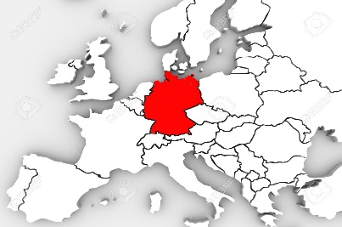


Next steps
1. New Geographies
Expand to new markets
2. New Data Sources
Inclusion of additional data to identify additional drivers of sales
3. Deep Dive
New insights and learnings for drivers
Actionable insights for WD if listing fee and additional information is available
4. Feedback
Iterate based on market feedback
Answer market specific questions
5. Budget Optimization
Based on market constraints and targets

Slide 27
APPENDIX

Slide 28
Increase of 10 points in weighted distribution has shown on average 2.5x impact on sales volume
B
A
Sales unit average
Weighted Distribution Average
Insights and Observations
On an average, 2.5x impact has been observed by an increase of 10 points in weighted distribution
It is recommended to increase weighted distribution by at least 10-15 points to observe significant uplift
Qualitative analysis needs to be performed to drive actionability from these insights i.e. How many stores constitute to 10 points increase, which stores should be targeted first, when should distribution be increase or decreased.

Slide 29
Increase of 4 points in weighted distribution has shown 3.7x impact on sales volume
B
A
Insights and Observations
3.7x impact has been observed by an increase of 4 points in weighted distribution
Distribution range of ‘4-6’ has similar effect on sales volume as ‘6-8’ and therefore, amount can be optimized to spend in other levers
It is recommended to increase weighted distribution by 4 points for maximum lift instead of 2 points as the impact remains similar

Slide 30
Increase of 10 points in weighted distribution has shown 3.3x impact on unit sales average
B
A
Insights and Observations
3.3x impact has been observed by an increase of 10 points in weighted distribution
Distribution range of ‘5-10’ has similar effect on sales volume as ’10-15’ and therefore, amount can be optimized to spend in other levers
It is recommended to increase weighted distribution by 10 points for maximum lift instead of 5 points as the impact remains similar
Qualitative analysis needs to be performed to drive actionability from these insights i.e. How many stores constitute to 10 points increase, which stores should be targeted first, when should distribution be increase or decreased.

Slide 31
France – Total Category
Weighted Distribution Buckets | (5 - 10) | (10 - 15) | (15 - 20) | (20 - 25) | (25 - 30) | (30 - 35) | (35 - 40) | more than 40
Units Sold | 1449 | 2368 | 2915 | 4385 | 5085 | 6449 | 6481 | 8270
Group | d | cd | cd | bc | b | b | ab | a

Slide 32
France - Auchan
Weighted Distribution Bucket | (0 - 10) | (10 - 20) | (20 - 30) | (30 - 40) | (40 - 50) | (50 - 60) | (60 - 70) | (70 - 80) | (80 - 90) | (90 - 100)
Units Sold | 73.54 | - | 920.5 | 1626.3 | 1864.5 | 2277.5 | 3265.6 | 3543.1 | 3829.4 | 4445.3
Groups | f |  | ef | e | de | cde | bcd | bc | b | a

Slide 33
France – Auchan Supermarche
Weighted Distribution Bucket | (0 - 5) | (5 - 10) | (10 - 15) | (15 - 20) | (20 - 25) | (25 - 30) | (30 - 35) | (35 - 40) | (40 - 45) | (45 - 50) | (50 - 55) | (55 - 60) | (60 - 65) | (65 - 70)
Units Sold | 12.5 | - | 349 | - | - | - | 920.3 | - | 1389.4 | 1389.5 | - | 1467.5 | 1584 | 1758.5
Groups | f |  | e |  |  |  | d |  | c | c |  | bc | b | a

Slide 34
France – Monoprix
Weighted Distribution Bucket | (5 - 10) | (10 - 15) | (15 - 20) | (20 - 25) | (25 - 30)
Units Sold | 504.25 | 674 | 930 | 1352.17 | 1785.18
Groups | d | cd | c | b | a

Slide 35
France – Franprix
Weighted Distribution Bucket | (1 - 5) | (5 - 10) | (10 - 15) | (15 - 20) | (20 - 25)
Units Sold | 227.33 | 483.04 | 619.4 | 848.08 | 983.94
Groups | c | b | b | a | a

Slide 36
France – Caramel & Almond & Sea salt
Weighted Distribution Buckets | (0 - 10) | (10 - 20) | (20 - 30) | (30 - 40) | (40 - 50)
Units Sold | 139.5 | 255.6 | 311.1 | 534.5 | 574.7
Groups | c | b | b | a | a

Slide 37
France – Fruit Nut & Almond & Coconut
Weighted Distribution Buckets | (0 - 10) | (10 - 20) | (20 - 30) | (30 - 40) | (40 - 50)
Units Sold | 389.7 | 430.6 | 837.7 | 979 | 1201
Groups | d | d | c | b | a

Slide 38
France – Nuts & Spices & Black Chocolate
Weighted Distribution Buckets | (0 - 10) | (10 - 20) | (20 - 30) | (30 - 40) | (40 - 50) | (50 - 60)
Units Sold | 361.2 | 550.5 | 1109 | 1241.4 | 1736.1 | 2474.1
Groups | d | d | c | c | b | a

Slide 39
France – Roasted Nut & Honey & Sea salt
Weighted Distribution Bucket | (0 - 10) | (10 - 20) | (20 - 30) | (30 - 40) | (40 - 50) | (50 - 60) | (60 - 70) | (70 - 80) | (80 - 90) | (90 - 100)
Units Sold | - | - | 254 | 383 | 991.2 | 506.5 | 649.5 | 729.2 | 880.3 | 1035.1
Groups | - | - | d | d | a | cd | bcd | bc | ab | a

Slide 40
France – SKU – Plus Peanut Butter & Dark Chocolate
Weighted Distribution Buckets | (0 - 10) | (10 - 20) | (20 - 30) | (30 - 40) | (40 - 50)
Units Sold | 215.2 | 393.62 | 556.7 | 990.1 | 1481.3
Groups | d | cd | c | b | a

Slide 41
Event sampling does not seem to show a significant impact unit sales average in Italy
AUDIT INFERENCES
Units sales does not significant correlation with the number of units sampled in events

Slide 42
Proximity sampling does not seem to show a significant impact unit sales average in Italy
AUDIT INFERENCES
Units sales does not significant correlation with the number of units sampled in proximity

Slide 43
On an average, 4 points increment in Weighted Distribution drives significant volume uplift - IT
Level 1 – Total
Category
Level 2 – Stock Keeping Unit (SKU)
Every “4 point” increment in weighted distribution, there is significant uplift in units sold
“Arac Mand Cioc Fond” shows significant volume uplift after every “4 point” increment in weighted distribution
“Arac Mand Noci Pecan” & “Arac Cioc Fond” shows significant volume uplift after every “2 point” increment in weighted distribution

Slide 44
Weighted distribution should be kept in lower range of WD groups to better allocate the budget in Italy
B
A
AUDIT INFERENCES
Unit sales behave similarly in two groups A & B of weighted distribution range
Lower range in WD group will give similar effect on sales and the spends can be better allocated to other levers
*WD analysis has been done excluding Carrefour as Nielson does not capture this banner

Slide 45
Italy SKU – Arac Mand Noci Pecan
Weighted Distribution Buckets | (5 - 7) | (8 - 10) | (11 - 14) | (15 - 17) | (18 - 19)
Units Sold | 456 | 869 | 1640 | 2945 | 2390
Group | C | C | B | A | AB

Slide 46
Italy SKU – Arac Mand Cioc Fond
Weighted Distribution Buckets | (5 - 7) | (8 - 10) | (11 - 14) | (15 - 17) | (18 - 19)
Units Sold | 495 | 1023 | 1308 | 3053 | 2924
Group | B | B | B | A | A

Slide 47
Italy SKU – Arac Mand Cioc Fond
Weighted Distribution Buckets | (4 – 7) | (8 - 10) | (11 - 14) | (15 - 17) | (18 - 19)
Units Sold | 220 | 1023 | 1308 | 3053 | 2924
Group | B | B | B | A | A

Slide 48
In general, every 10 point increment in Weighted Distribution at any level has significant volume uplift.
Level 1 – Total Category
Level 2 – City
Level 3- SKU
Every “10 point” increment in weighted distribution, there is significant uplift in units sold
Moscow: shows significant volume uplift after every “10 point” increment in weighted distribution
St.Petersburg: shows significant volume uplift in (15-20) range of weighted distribution
DC & Nuts & Sea salt sales is not significantly affected by increment in weighted distribution
Honey & Nut & SeaSalt
Almond & Coconut
DC & Peanut Butter
shows significant volume uplift after every “10 point” increment in weighted distribution
Almond & Caramel & Sea Salt shows significant volume uplift after every “15 point” increment in weighted distribution

Slide 49
Russia –Moscow
Weighted Distribution Group 01-05 05-10 10-15 15-20 20-25
Units 1403.6 2790.25 3846.2 8287.769 8401.25
groups c bc b a a

Slide 50
Russia –St.Petersburg
Weighted Distribution Group 05-10 10-15 15-20 20-25 25-30 30-35
Units 356.6667 825.3333 1895.25 1464.6667 1118 1144
Groups b b a ab ab ab

Slide 51
Russia –BE-KIND MSL BAR HONEY&NUT&SEA SALT S 0.04KG
Weighted Distribution Group 0-5 05-10 10-15 15-20 20-25
Units 482.75 757.5 1341.412 1616.2 1509
groups b b a a a

Slide 52
Russia –BE-KIND MSL BAR ALMND&COCNT S 0.04KG
Weighted Distribution Group 0-5 05-10 10-15 15-20 20-25 25-30
Units 331.4 616.6667 778.8 1076 2074.6 2067.7143
Groups b b b ab a a

Slide 53
Russia –BE-KIND MSL BAR ALMN&CARML&SEA SALT S 0.04KG
Weighted Distribution Group 0-5 05-10 10-15 15-20 20-25 25-30
Units 208.4 510.3333 751 2334.75 2252.6 2552.5
Groups b b b a a a

Slide 54
Russia –BE-KIND MSL BAR DARK CHOCL&PEANUT BUTR S 0.04KG
Weighted Distribution Group 00-05 05-10 10-15 15-20 20-25
Units 266 459.8 792.8333 789.5 870
Groups b b a a a

Slide 55
Russia – BE-KIND MSL BAR MAPLE SYR&PECAN&SEA SAL S 0.04KG
Weighted Distribution Group 0-5 05-10 10-15 15-20
Units 255 735.6364 948.75 940
Groups a a a a

Slide 56
Russia – BE-KIND MSL BAR DARK-CHCLT&NT&S-SLT S 0.04KG
Weighted Distribution Group 18-20 20-22 22-24 24-26 26-28 28-30 30-32
Units 1018 2612 2039.167 2597.333 1897 1551.5 2557
Groups a a a a a a a

Slide 57
Significant Marketing Levers
Insignificant Marketing levers
Key Messages
Paid Media – Instagram
Social Media – Instagram
Instore Demo
Event Sampling
Social Media – Facebook
Paid Media – Facebook
Levers with less data to Quantify impact
Weekly Volume Uplift (%)
Proximity Sampling
Search Engine Advertisement
Influencer Marketing
Paid Media – Instagram & Social Media – Instagram are top 2 levers with 8.4 % and 3.5 % respectively.
Other significant levers like instore demo & event sampling are also covered in volume uplift slide

Slide 58
Thank you.

